Slide 1
Computer Engineering Department
A.P. Shah Institute of Technology
G.B.Road,Kasarvadavali, Thane(W), Mumbai-400615 UNIVERSITY OF MUMBAI
Academic Year 2021-2022

Slide 2
Kalpavriksha admission Chatbot
A Project Report on
Submitted in partial fulfillment of the degree of
Bachelor of Engineering(Sem-IV/VI)
in
Computer Engineering
By
Yash Pol (19102068)
Amish Nandu(18102048)
Vinit Agivale(16102047)
Akshen Dhami(18102032)
Under the Guidance of
Rushikesh Nikam

Slide 3
1.Project Conception and Initiation

Slide 4
1.1 Abstract
A Chat-bot is a software application used to conduct an online chat conversation via text or text-to speech, instead of providing direct contact with a live human agent.
Designed to convincingly simulate the way a human would behave as a conversational partner. In the proposed system, we presented a chatbot that generates a dynamic response for online client's queries. The Proposed System is based on Artificial Intelligence-powered Chatbot.
This proposed chatbot identifies the user context which triggers the particular intent for a response.. The proposed system used machine learning algorithms to learn the Chatbot by experiencing various user's responses and requests..

Slide 5
1.2 Objectives
The chatbot will be designed in such a way to make the students feel like talking to the staff from college and their queries are addressed through the conversational text .
The AI feature makes the bot smart and answers the queries of user like academic activities ,admission enquiry, fees structure, scholarship details, time-table of every department, details of the documents required to attach etc.
With this chat-bot system it will be easy for the student to directly clear their queries in lesser time.

Slide 6
1.3 References and their key takeaways
1. Research Paper on Chatbot for Student Admission Enquiry-They have used Rasa NLP, we have used dialog flow to make interaction with chatbot and also the NLP toolkit. 2. An Interpretation and Implementation of Chatbot Using Dialog Flow for an Education Domain-With the aid of digital technology like Artificial Intelligence, they created a new way to connect with their customers. 3. AI And Web-Based Interactive College Enquiry Chatbot- ApsitBot is a steppingstone technology developed with Natural Language Processing and Artificial Intelligence. It is a web-based application that uses Natural Language Processing Libraries and Machine Learning to have conversations with humans 4. COLLEGE ENQUIRY CHATBOT- The main objectives of the project were to develop an algorithm which will be wont to identify answers associated with user submitted questions

Slide 7
1.4 Problem Definition
We propose a AI based chatbot system to which student/user will be able to ask various questions right from placements, courses ,fee structures, scholarships, etc and the chatbot will reply to all the user queries since College admissions are a time consuming process and students have to visit the college to enquire about details.

Slide 8
1.5 Scope
Artificial Chatbots, Chatbot & AI ,Google cloud are the latest machine learning program in the market. Some of the Big companies, Big businesses implemented chatbots for 24/7 customer support.AI chatbots are beneficial for students and people in general who want know information of college. The Conversation AI chatbots have many advantages for students with disabilities as well because we have virtual call agent who answer queries through speech
AI Chatbot for student
Digital virtual assistant who will answer queries through speech

Slide 9
1.6 Technology stack
● Hardware Requirements:
i3 Processor Based Computer
Min 4GB-Ram
Hard Drive Storage
Monitor
● Software Requirements:
GCP
Dialogflow
Uneeq
Html,Javascript,json

Slide 10
1.7 Benefits for environment & Society
●Query will be solved 24/7.
●The chatbot assists students in staying informed about college-related events and aims to save time for students, parents, and faculty at the institution.
●Virtual call assistant will be benefial for blind students as it will help in clearing their queries by voice commands.

Slide 11
2. Project Design

Slide 12
2.1 Proposed System
A Kalpavriksha Admission Chatbot is constructed mistreatment artificial algorithms that analyzes user’s queries and perceive user’s message. This System could be a internet application that provides answer to the question of the scholar. Students simply have to be compelled to question through the chatbot that is employed for chatting. The System uses in-built computing to answer the question. The answers ar acceptable what the user queries. If the solution found to invalid, user simply got to choose the invalid answer button which is able to give notice the admin regarding the inaccurate answer. Admin will read invalid answer through portal via login System permits admin to delete the invalid answer or to feature a particular answer of that equivalent question. The User will question any faculty connected activities through the system. The user doesn't have to be compelled to in person move to the school for enquiry. The System analyzes the question then answers to the user.

Slide 13
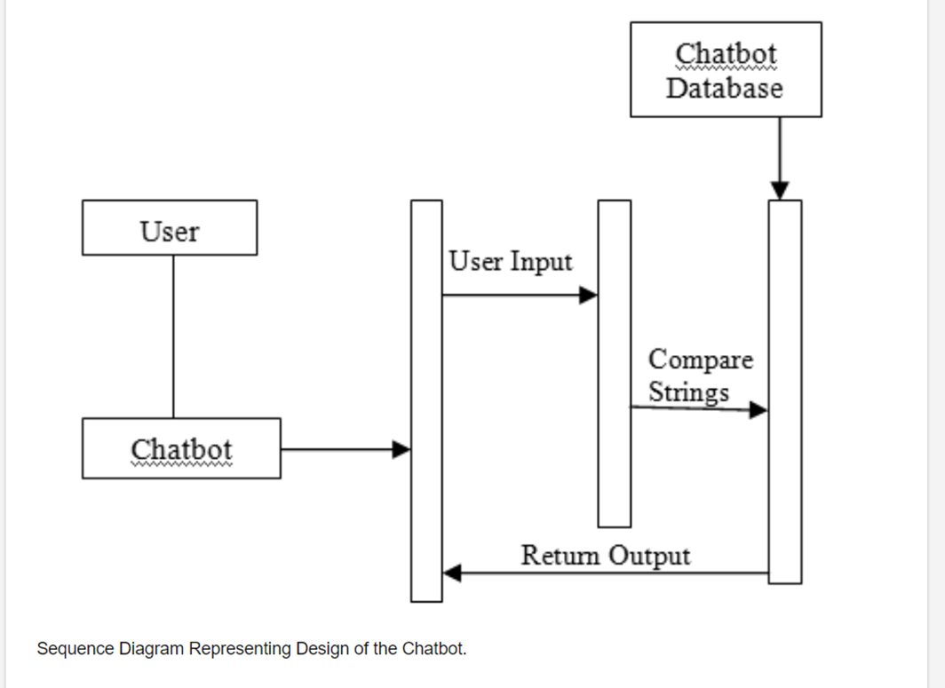
2.2 Design(Flow Of Modules)

Slide 14
2.3 Description Of Modules / Use Case
Dialogflow is a Google-owned framework that enables users to develop human-computer interaction technologies that can support Natural Language Processing (NLP). Basically, it lets you make Digital Programs that interact with end users through natural languages.
Agent – An agent is merely another term used to refer to the chatbot. Sometimes people say ‘agent’ when referring to the processing module within the application that enables discussions with the chatbot.
Entities: ‘Entities’ are Dialogflow’s mechanism for identifying and extracting useful data from natural language inputs. An Intent limits the bot to the scope of the user input. Entities enable it to extract specific pieces of information from your users
Virtual Call Assistant-Instead of chatting we can dial no and ask queries and have the same experience like chatting with chatbot.

Slide 15
3.Implementation

Slide 16
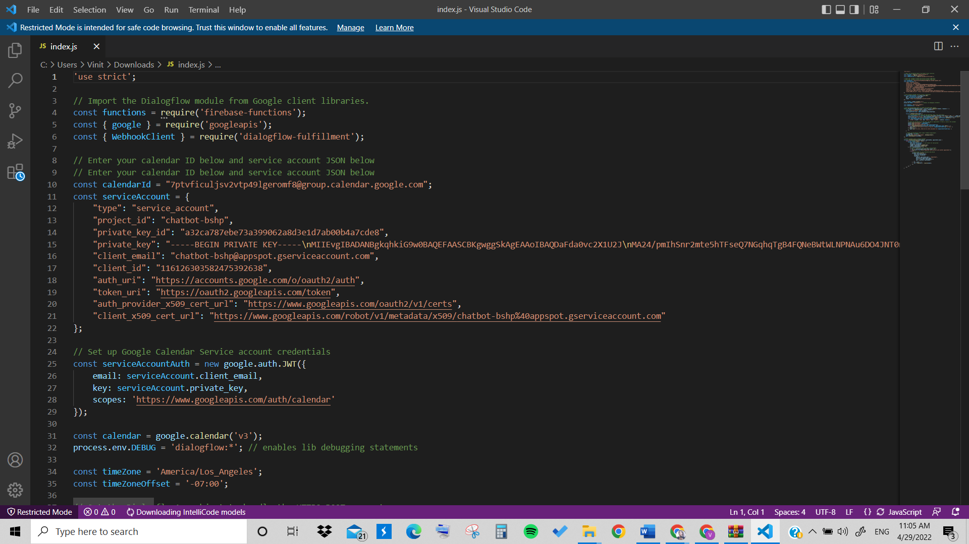
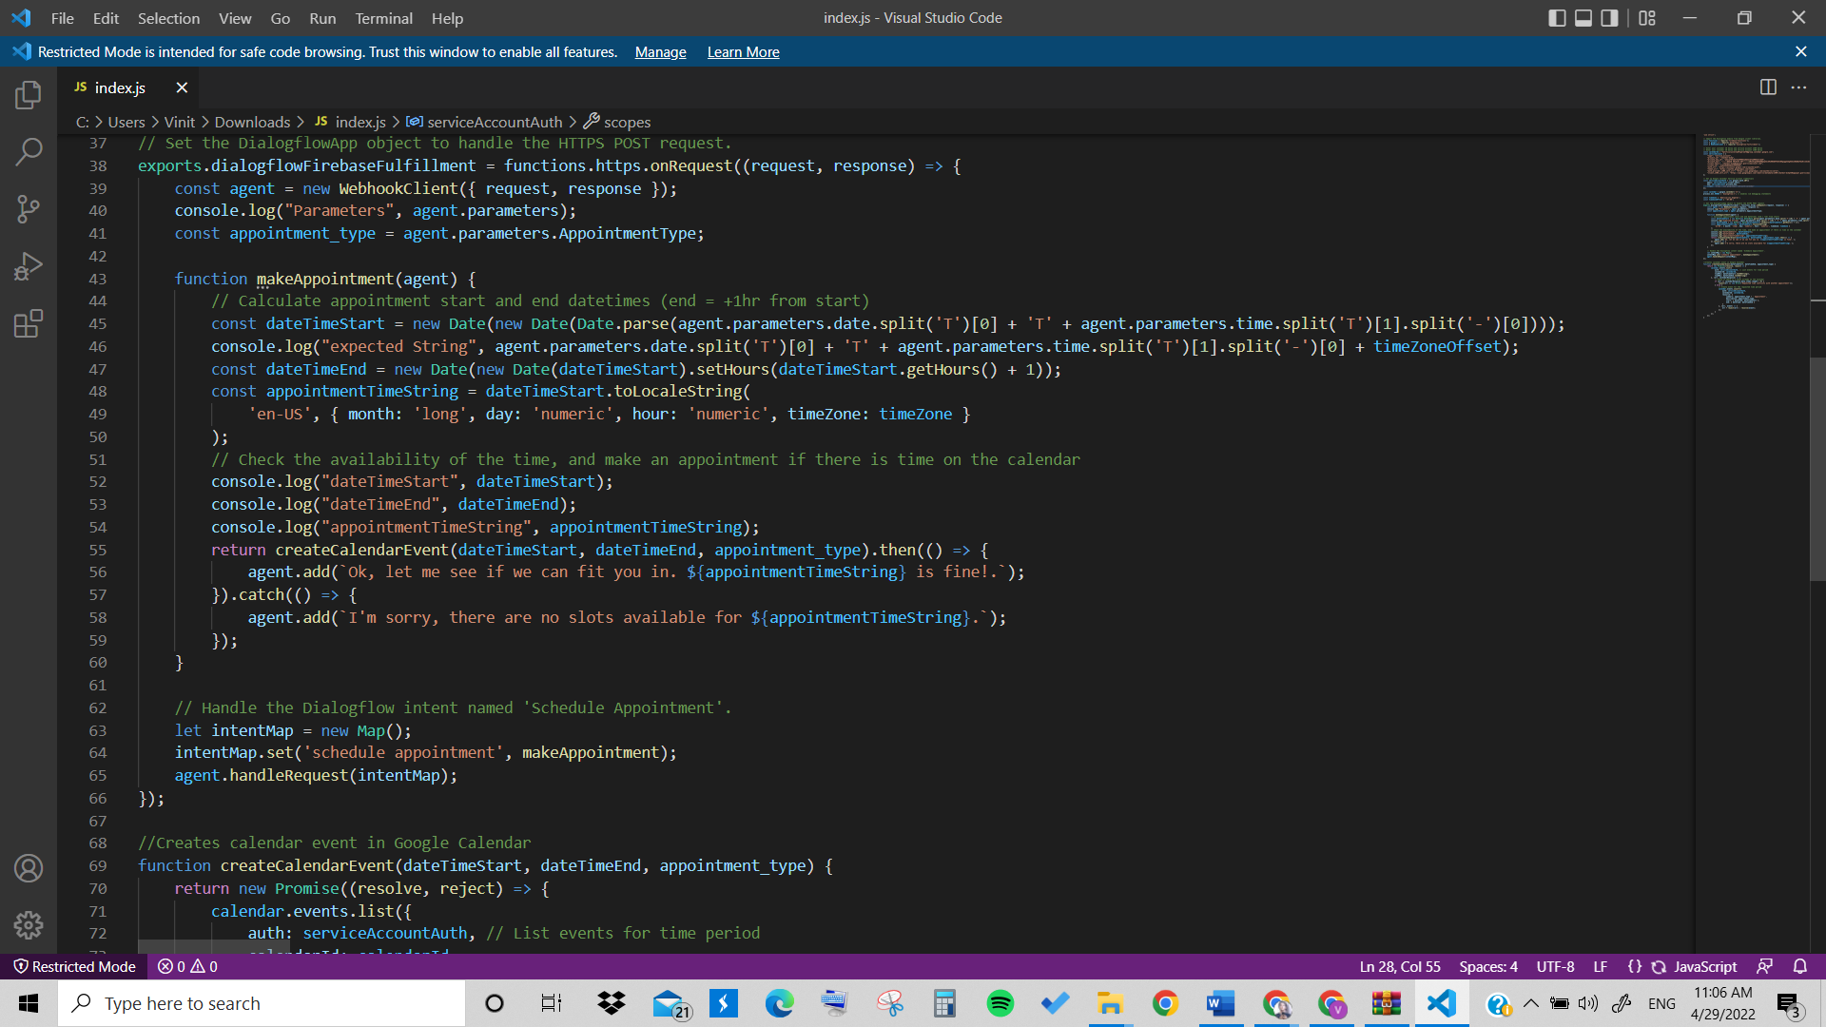
3.2 Execution

Slide 17
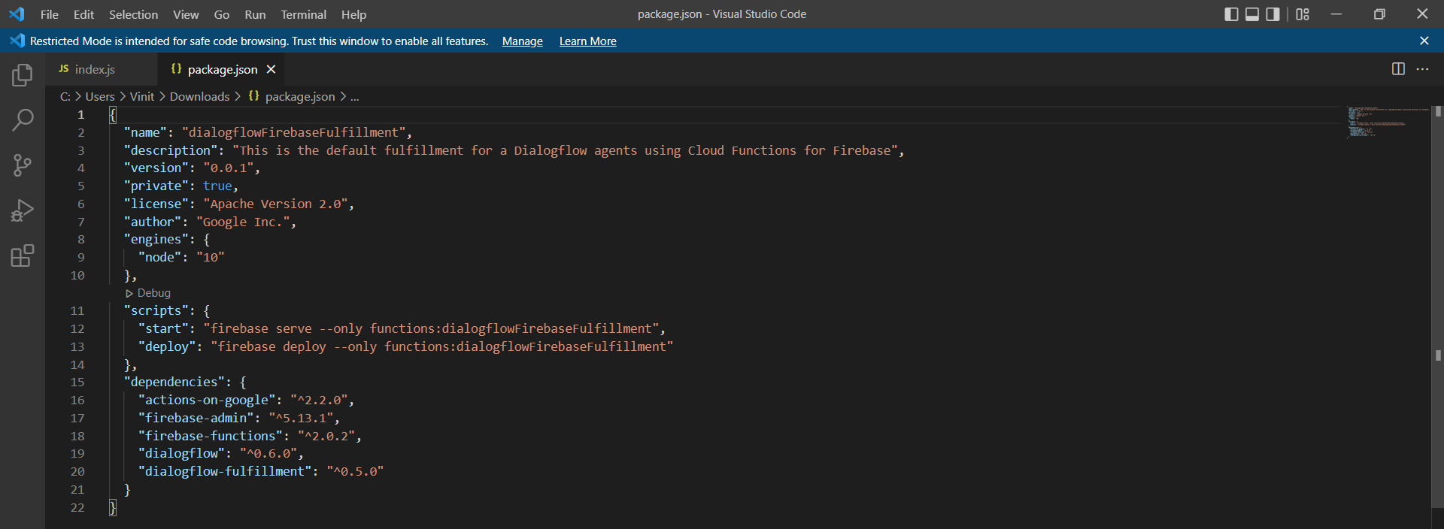
Execution

Slide 18
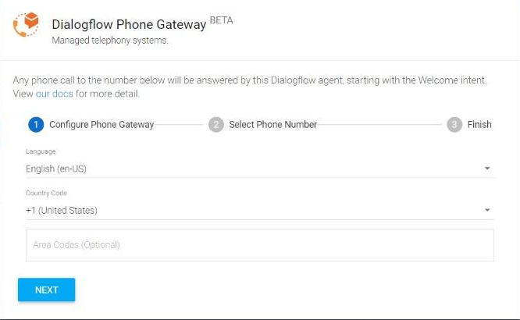
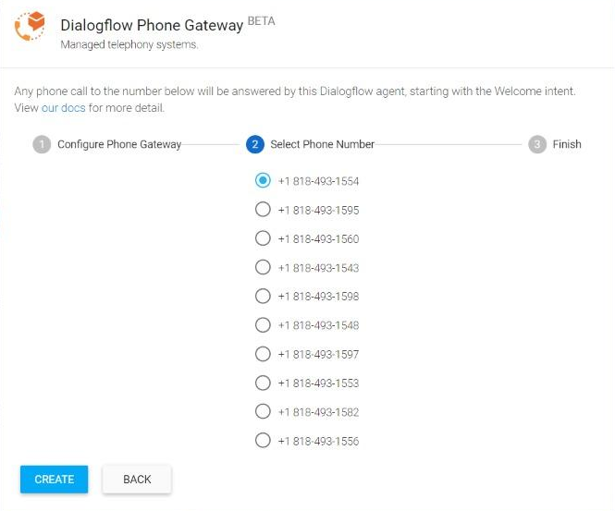
3.Call Assistant Chatbot

Slide 19
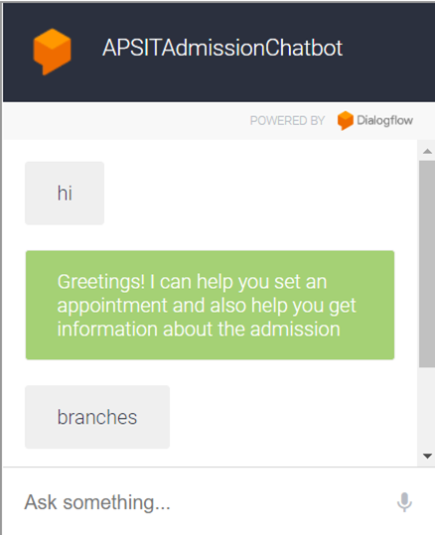
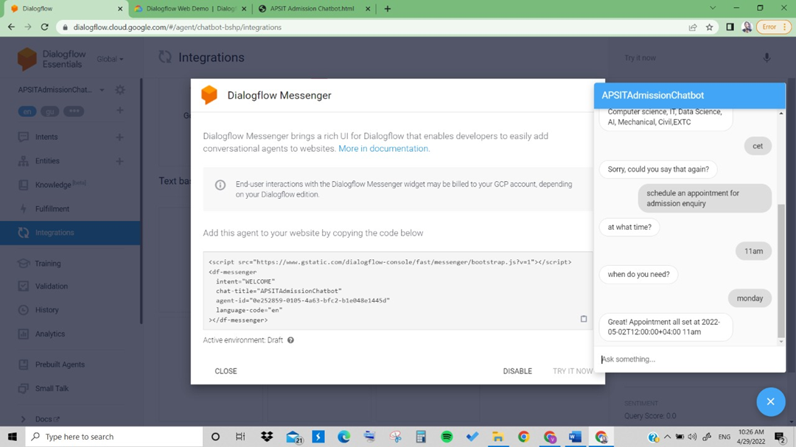
4. Results
Web Based Chatbot Messenger based Chatbot

Slide 20
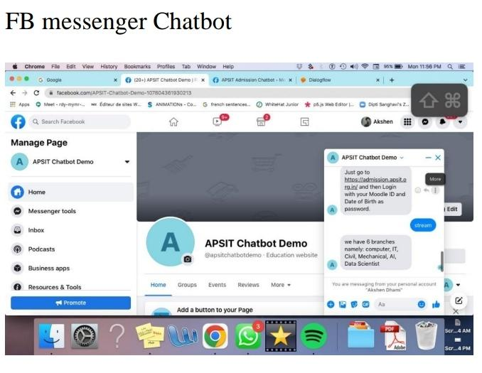
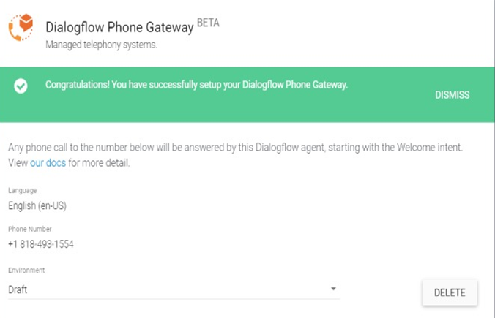
Call Assistant Chatbot

Slide 21
5.Conclusion
The main objectives of the project were to develop an algorithm that will be used to identify answers related to user submitted questions. To develop a database were all the related data will be stored and to develop a web interface. The web interface developed had two parts, one for simple users and one for the administrator.
A background research took place, which included an overview of the conversation procedure and any relevant chat bots available. A database was developed, which stores information about questions, answers, keywords, logs and feedback messages. A usable system was designed, developed and deployed to the web server on two occasions. An evaluation took place from data collected by potential students of the University. Also after received feedback from the first deployment, extra requirements were introduced and implemented.

Slide 22
6.References
Prakhar Srivastava, Nishant Singh, ” Automatized Medical Chat bot (Medibot)” , IEEE, 2020.
Bhavika R. Ranoliya , Nidhi Raghuwansh and Sanjay Singh , “Chatbot for University Related FAQs” ,IEEE, 2017.
Ankil Shah, Bhargav Jain, Bhavin Agrawal, Saurabh Jain, Simon Shim, “Problem Solving Chat bot for Data Structures” ,IEEE, 201
Jitendra Purohi,, Aditya Bagwe, Rishbh Mehta, OjaswiniMangaonkar , Elizabeth George, “Natural Language Processing based Jaro-The Interviewing Chatbot” , IEEE, 2019.
Tussanai Parthornratt, Pasd Putthapipat, Dollachart Kitsawat , Prapap Koronjaruwat, ” A Smart Home Automation via Facebook Chat bot and Raspberry Pi” , IEEE, 2018.

Slide 23
Thank You

